Slide 1
VPN SEED Lab
Matt Smith

Slide 2
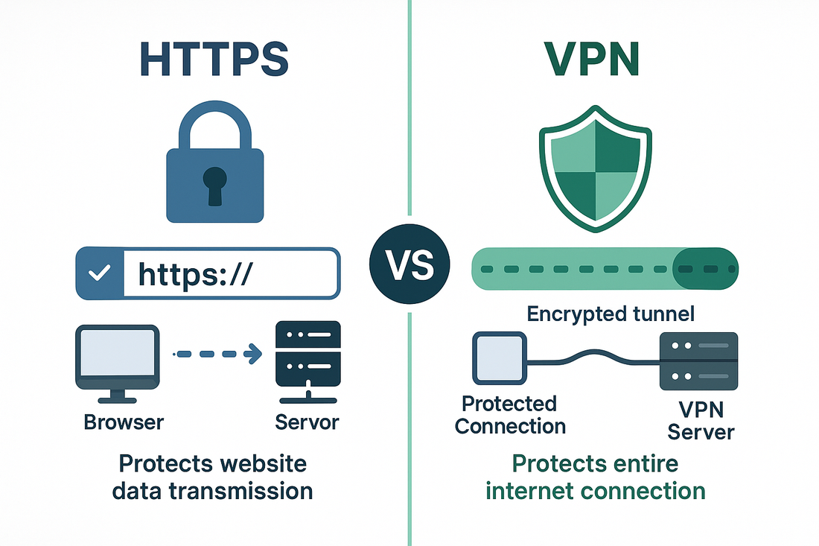
Why VPNs Matter in Modern Cybersecurity
The internet is an inherently insecure medium: data in transit is vulnerable to interception, tampering, and eavesdropping
Organizations rely on VPNs to extend private networks securely over public infrastructure
TLS/SSL-based VPNs are among the most widely deployed security technologies in enterprise, remote work, and cloud environments
Building a VPN from scratch reveals the layered interplay of cryptography, networking, and authentication, the core pillars of applied security
Key Words:
VPN: Virtual Private Network
TLS: Transport Layer Security
SSL: Secure Sockets Layer

Slide 3
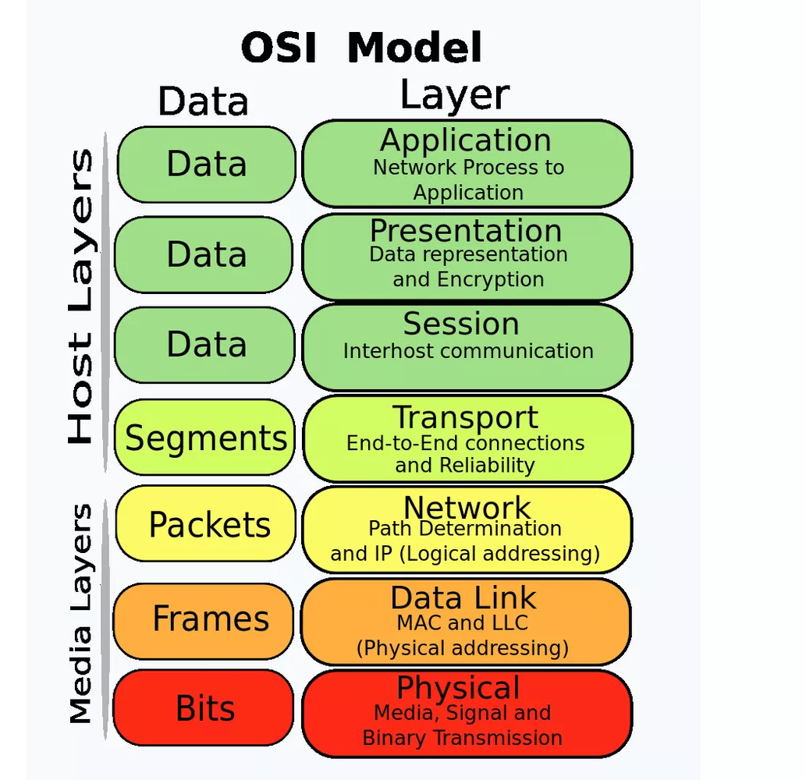
Where the Problem Lives: The OSI Context
7
6
5
4
3
2
1
At Layer 3 (Network), IP packets are transmitted with no inherent confidentiality or integrity guarantee
At Layer 4 (Transport), TCP/UDP sessions are susceptible to hijacking and replay attacks
Standard routing exposes source/destination metadata and payload content to any intermediary node
The core issue: How do we securely tunnel Layer 3 traffic across an untrusted Layer 3 network?
TLS operates at Layer 5–6 (Session/Presentation) and provides the cryptographic wrapper that solves this problem
Key Words:
IP: Internet Protocol
TCP: Transmission Control Protocol
UDP: User Datagram Protocol

Slide 4
Roadmap
Background: Network topology, implementation overview, and relevant protocols
Design Overview: Task summary table and completion status
Task Walkthroughs: Tasks 1 through 6 with demos, Q&A, and takeaways
Attack Mitigation & Generalization: MITM demonstration and countermeasures
Conclusion: Summary, problem solution, and future directions
Self-Reflection

Slide 5
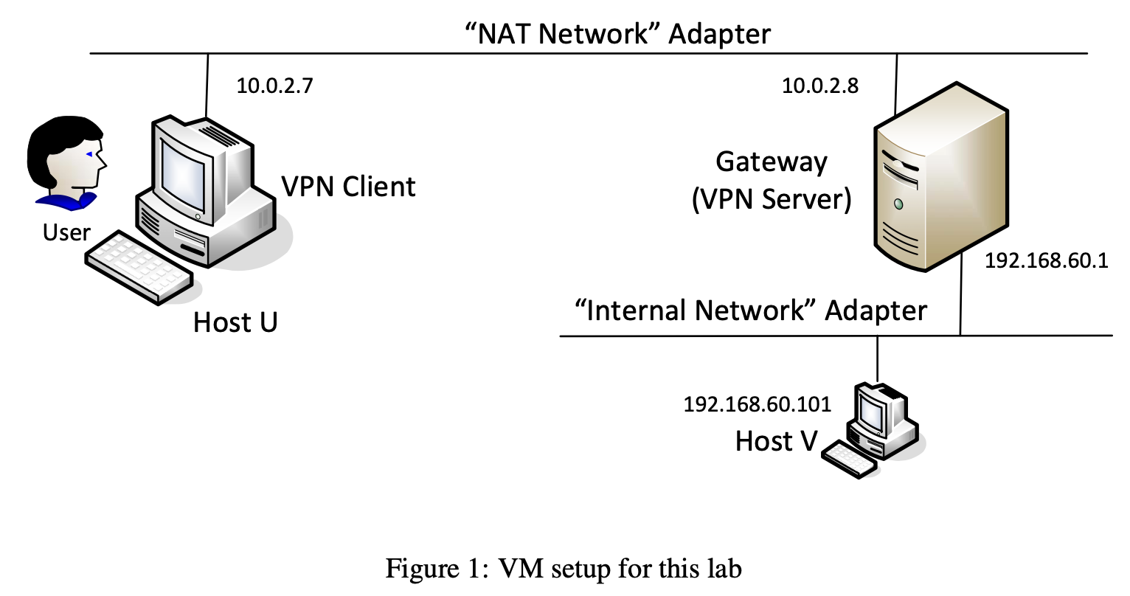
Lab Network Topology
Key Words:
NAT: Network Address Translation
LAN: Local area network
TUN: network TUNnel
Three VMs form the lab environment:
Host U / VPN Client: 10.0.2.7 (NAT Network)
Gateway / VPN Server: 10.0.2.8 (NAT Network) + 192.168.60.1 (Internal Network)
Host V: 192.168.60.101 (Internal Network only)
Host V is not directly reachable from Host U without the VPN tunnel
The NAT Network simulates the public internet; the Internal Network simulates a private corporate LAN
TUN interfaces (tun0) are assigned 192.168.53.1 (server) and 192.168.53.5 (client) to form the tunnel subnet

Slide 6
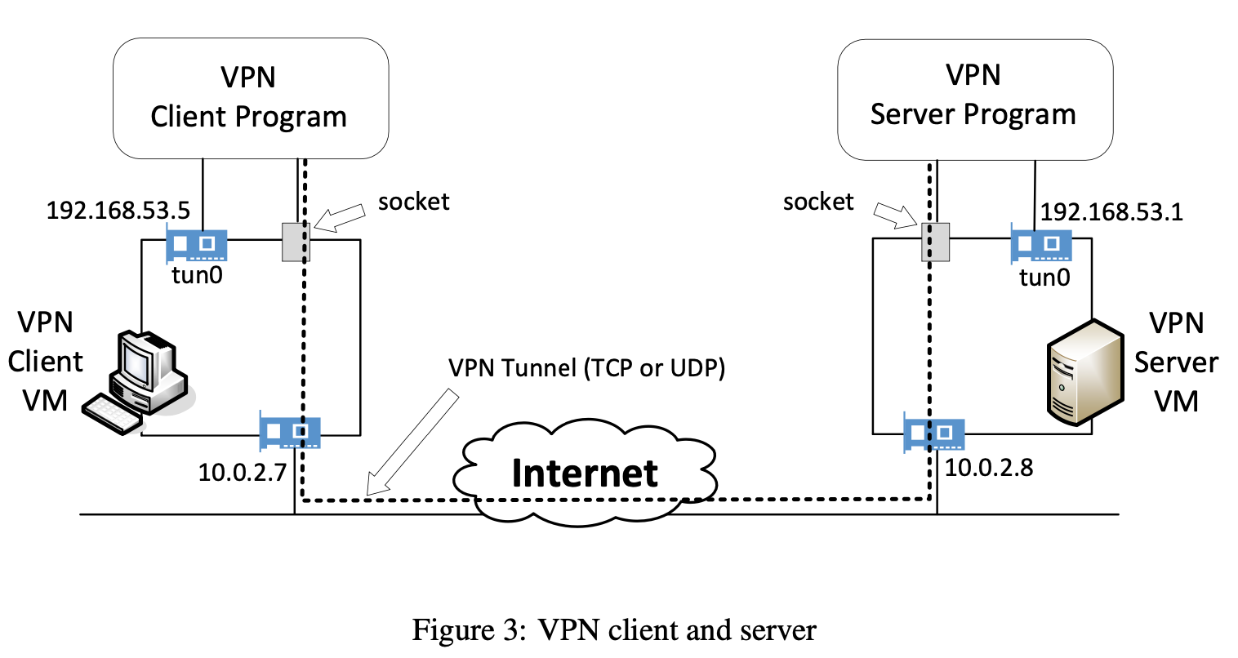
How miniVPN Works
miniVPN is a TLS/SSL VPN built from scratch in C using the OpenSSL library
Two core programs: vpnclient (on Host U) and vpnserver (on the Gateway)
Communication between ends uses a TCP socket wrapped in a TLS session
Both programs attach to a TUN virtual interface, an OS-level virtual network device
Packet flow:
Application generates IP traffic → kernel routes it to tun0
VPN program reads from tun0, encrypts, sends over TLS tunnel
Remote VPN program decrypts, writes back to its tun0
Remote kernel delivers the packet to the destination host

Slide 7
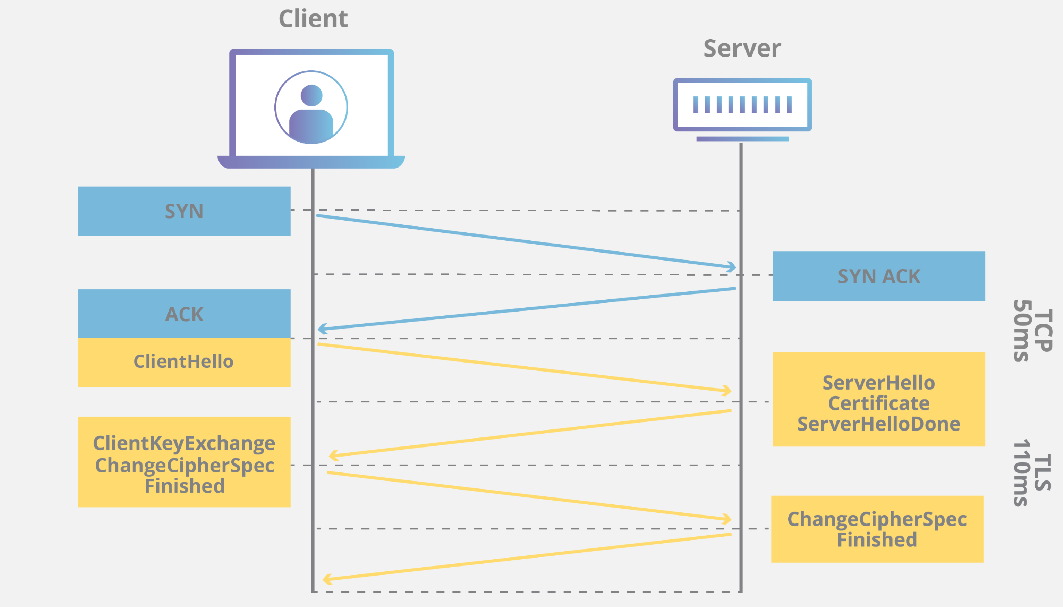
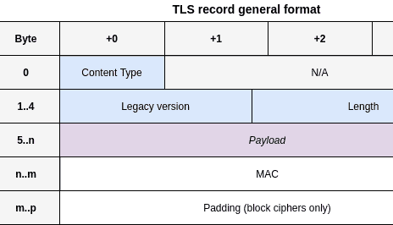
TLS - The Protocol Securing Our Tunnel
TLS (Transport Layer Security) provides confidentiality, integrity, and authentication over TCP
TLS record header fields:
Content Type (1 byte): handshake, alert, application data, change cipher spec
Version (2 bytes): e.g., TLS 1.2 = 0x0303
Length (2 bytes): size of the payload
The TLS Handshake negotiates: cipher suite, exchanges certificates, and establishes session keys
X.509 certificates authenticate the server (and optionally the client) using a PKI chain of trust
After the handshake, all tunnel data is encrypted with the negotiated symmetric key (e.g., AES-256-GCM)
Key Words:
PKI: Public Key Infrastructure
AES: Advanced Encryption Standard
GCM: Galois/Counter Mode

Slide 8
miniVPN - Task Overview and Completion Status
Task | Objective | Status
Task 1: VM Setup | Configure three-VM network environment | Complete
Task 2: VPN Tunnel via TUN/TAP | Create an unencrypted IP tunnel using virtual interfaces | Complete
Task 3: Encrypt the Tunnel | Replace UDP with TCP + add TLS encryption | Complete
Task 4: Authenticate the VPN Server | Use X.509 certificates to verify server identity | Complete
Task 5: Authenticate the VPN Client | Password-based user authentication via shadow file | Complete
Task 6: Support Multiple Clients | Fork-based multi-client support with IPC pipes | Complete
Key Words:
1) IPC: Inter-Process Communication

Slide 9
Task 1 - Configuring the Virtual Network Environment
Demo content:
ifconfig output on all three VMs confirming IP assignments
last reboot; date confirming fresh boot state
routing tables on all three VMs (route -n or ip route)
Task questions / answers:
Q: Why does Host V need static IP configuration? A: VirtualBox provides no DHCP on Internal Network mode, static assignment is required
Q: Why can't Host U reach Host V directly? A: Host V only has an Internal Network adapter; it has no route reachable from the NAT Network
Main takeaway: Network topology and correct IP/routing configuration are the prerequisite for everything that follows, misconfiguration here cascades into every subsequent task
Key Words:
DHCP: Dynamic Host Configuration Protocol

Slide 10
Task 2 - Building the IP Tunnel with TUN/TAP
Demo content:
vpnserver and vpnclient running, tun0 interfaces appearing (ifconfig tun0)
ping 192.168.60.101 from Host U succeeding through the tunnel
Wireshark on the NAT interface: outer UDP/TCP packets carrying encapsulated IP payloads
Task questions / answers:
Q: What happens when you break the tunnel mid-telnet session? A: The telnet window freezes; keystrokes are not transmitted. The TCP connection is not immediately broken as it is suspended. Upon tunnel reconnection, the telnet session resumes because the TCP state was preserved end-to-end
Q: What is the source IP seen by Host V? A: 192.168.53.5 (the tun0 address of the VPN client), the inner IP
Main takeaway: TUN/TAP virtualizes a network layer device in software, enabling user-space programs to intercept and forward IP traffic, the fundamental mechanism behind all software-defined VPNs

Slide 11
Task 3 - Securing the Tunnel with TLS
Demo content:
Wireshark capture on the NAT interface: all tunnel traffic labeled as TLS, payload unreadable
Wireshark with server private key loaded: traffic successfully decrypted, revealing inner IP packets
the code change from UDP socket to TCP socket + SSL_write / SSL_read replacing raw send / recv
Task questions / answers:
Q: Why must we switch from UDP to TCP before adding TLS? A: TLS requires a reliable, ordered byte stream as it is built on top of TCP. UDP does not provide delivery guarantees that TLS depends on
Q: What does Wireshark show before vs. after encryption? A: Before: plaintext IP packet contents visible in payload. After: only TLS record headers visible; application data is ciphertext
Main takeaway: TLS transforms our raw tunnel into a cryptographically secure channel, providing both confidentiality (AES encryption) and integrity (MAC/AEAD), with minimal code changes using OpenSSL
Key Words:
AEAD: Authenticated Encryption with Associated Data

Slide 12
Task 4 - Server Authentication via X.509 Certificates
Demo content:
successful connection when client connects to the correct hostname (matching CN/SAN in the certificate)
failed connection (with error message) when an incorrect/mismatched hostname is used, simulating a MITM scenario
the relevant code lines performing the three verification steps
Task questions / answers:
Three verifications and their code locations:
Certificate validity: SSL_CTX_load_verify_locations() + OpenSSL's internal chain verification during handshake
Server owns the certificate: TLS handshake: server signs a challenge with its private key; SSL_get_verify_result() confirms
Server is the intended host: manual hostname check using X509_check_host() or comparing CN against the user-supplied hostname
Q: What line forces the handshake to abort on failure? A: SSL_CTX_set_verify(ctx, SSL_VERIFY_PEER, NULL), instructs OpenSSL to abort if peer certificate verification fails
Main takeaway: Without hostname verification, a valid certificate from a different server could pass chain validation as all three checks together are required to defeat impersonation attacks
Key Words:
CN: Common Name
SAN: Subject Alternative Name

Slide 13
Task 5 - Client (User) Authentication via Shadow File
Demo content:
client prompting for username and password (using getpass(): input not echoed)
successful login with valid credentials → tunnel established
failed login with invalid credentials → connection dropped by server, no tunnel
Task questions / answers:
Q: Which code sends credentials to the server? A: After TLS session is established, client calls SSL_write(ssl, username, ...) and SSL_write(ssl, password, ...), transmitted securely inside the encrypted tunnel
Q: Which code reads from the shadow file? A: getspnam(username) retrieves the hashed password entry; crypt(input_password, stored_hash) recomputes the hash; strcmp() compares the result
Q: Why must authentication happen after TLS handshake? A: Credentials travel inside the encrypted tunnel, sending them before TLS would expose them in plaintext
Main takeaway: The ordering matters: establish the encrypted channel first, then authenticate the user through it as this prevents credential interception

Slide 14
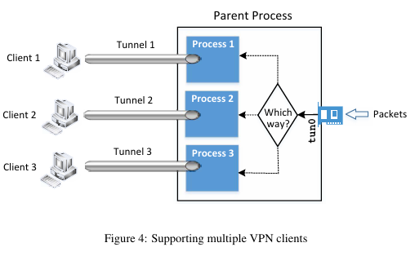
Task 6 - Multi-Client VPN Server with IPC
Demo content:
two separate VPN clients connecting to the server simultaneously
both clients able to ping/telnet Host V through their respective tunnels concurrently
process tree (ps aux) confirming parent + child processes
Task questions / answers:
Q: How does the server decide which tunnel an incoming packet from Host V goes to? A: The parent process reads the destination IP from the inner IP packet header and maps it to the corresponding client's tunnel using a routing/client table
Q: How does the parent pass packets to the correct child process? A: Via pipe(), each child has a dedicated pipe; parent writes to fd[1], child reads from fd[0]
Q: How do child processes monitor both the pipe and the TLS socket simultaneously? A: Using select(), monitors multiple file descriptors, blocking until any one of them has data
Main takeaway: Real-world VPN servers must multiplex many concurrent tunnels, fork() + pipe() + select() is a classic Unix pattern for concurrent I/O with process isolation

Slide 15
Extended Task - Man-in-the-Middle Attack Demonstration
Demo content:
simulated MITM setup: attacker intercepts traffic between Host U and VPN Server, presenting a forged/self-signed certificate not signed by the trusted CA
client-side error output when the forged certificate is rejected (certificate chain verification failure)
Wireshark confirming the attacker is in the path but cannot decrypt or impersonate successfully
Explanation:
The attacker can intercept TCP packets but cannot forge a certificate trusted by our CA
Without the server's private key, the attacker cannot complete the TLS handshake in the server's name
OpenSSL's SSL_get_verify_result() returns non-zero; our code checks this and terminates the connection
Key Words:
CA: Certificate Authority

Slide 16
How miniVPN Defeats MITM Attacks
Attack Vector | Countermeasure in miniVPN
Fake server certificate | TLS chain verification: certificate must be signed by our trusted CA
Certificate belonging to a different server | Hostname verification: CN/SAN must match the user-specified hostname
Replay attacks | TLS sequence numbers and MAC prevent replayed records from being accepted
Credential theft | Credentials sent only after TLS session is established, always encrypted
Eavesdropping | AES-256 encryption of all tunnel payloads via TLS
Key principle: Defense in depth as no single check is sufficient; the combination of PKI, hostname verification, and tunnel encryption closes the MITM attack surface

Slide 17
Extending the Methodology - Broader Implications
The MITM vulnerability we demonstrated is not unique to VPNs: it applies to any TLS-protected protocol (HTTPS, IMPAC, etc)
Certificate pinning extends our approach: applications can pin an expected certificate fingerprint, rejecting even legitimately CA-signed certificates that don't match
Mutual TLS (mTLS) generalizes client authentication with certificates which is used in zero-trust architectures and service meshes (e.g., Kubernetes)
DNS-based MITM: an attacker who controls DNS can redirect hostname resolution, countered by DNSSEC and certificate transparency logs
The TUN/TAP tunneling pattern is also used in: WireGuard, OpenVPN, Tor, and container networking, understanding miniVPN provides direct insight into all of these

Slide 18
What We Built and What We Learned
Implemented miniVPN: a functional TLS/SSL VPN from scratch in C, covering the full stack from virtual network interfaces to PKI-based authentication
Task 1: Three-VM topology simulating real-world internet + private network separation
Task 2: IP tunneling via TUN/TAP with correct routing
Task 3: Cryptographic tunnel security via TLS over TCP
Task 4: Server authentication using X.509 certificates and hostname verification
Task 5: User authentication via Linux shadow file, transmitted securely inside the tunnel
Task 6: Multi-client concurrency using fork, pipes, and select

Slide 19
Solving the Core Problem
Problem stated: IP traffic across untrusted networks (Layer 3) has no inherent confidentiality, integrity, or authentication
Solution demonstrated: TLS/SSL VPN wraps Layer 3 packets inside an encrypted Layer 4/5 session, providing:
Confidentiality: AES encryption hides payload content
Integrity: AEAD/MAC prevents undetected tampering
Authentication: PKI verifies server identity; password/shadow verifies user identity
The result: Host U can communicate with Host V as if on the same private network, with all traffic cryptographically protected end-to-end across a simulated untrusted internet

Slide 20
Where to Go From Here
Mutual TLS (mTLS): Replace password authentication with client-side X.509 certificates for stronger, phishing-resistant authentication
01
IKEv2/IPSec comparison: Explore how IPSec-based VPNs differ architecturally: operating at Layer 3 rather than Layer 4/5
02
Modern protocols: Analyze WireGuard's approach: a leaner, kernel-integrated VPN using Curve25519 and ChaCha20-Poly1305 instead of the full TLS stack
03
Performance hardening: Explore multi-threading (vs. multi-processing) for the multi-client server; measure throughput and latency under load
04
Zero-trust integration: How does the VPN model evolve when perimeter-based security is abandoned in favor of identity-based, per-request authentication?
05

Slide 21
Self-Reflection
What went well:
[e.g., TLS integration was smoother than expected once the certificate chain was set up correctly]
[e.g., The routing logic in Task 2 clicked once we traced packets in Wireshark]
What was challenging:
[e.g., Debugging the multi-client pipe/select interaction — race conditions were subtle]
[e.g., Understanding why hostname verification requires a separate explicit check beyond chain validation]
What I would do differently:
[e.g., Set up Wireshark capture profiles earlier — it would have saved hours of debugging]
[e.g., Test the tunnel-breaking scenario earlier to understand TCP state behavior]
Key personal insight:
[e.g., Building security from scratch makes abstractions concrete — it is one thing to know TLS exists, another to implement the handshake verification yourself]

